Slide 1
What is gcc suite ?
The GNU Compiler Collection, commonly known as GCC, is a set of compilers and development tools available for Linux, Windows, various BSDs, and a wide assortment of other operating systems
It includes support primarily for C and C++ and also includes Objective-C, Ada, Go, Fortran, and D programming languages
The Free Software Foundation (FSF) wrote GCC and released it as completely free (as in libre) software.

Slide 2
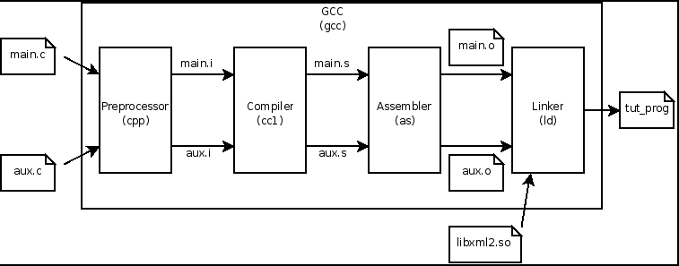
GNU C Compiler

Slide 3
GNU binutils
The GNU Binutils are a collection of binary tools.
The main ones are:
gdb – the GNU debugger
ld - the GNU linker.
as - the GNU assembler.
But they also include:
nm - Lists symbols from object files.
objdump - Displays information from object files.
objcopy - Copies and translates object files.
readelf - Displays information from any ELF format object file.
size - Lists the section sizes of an object or archive file.
addr2line - Converts addresses into filenames and line numbers
strings - Lists printable strings from files.
strip - Discards symbols.

Slide 4
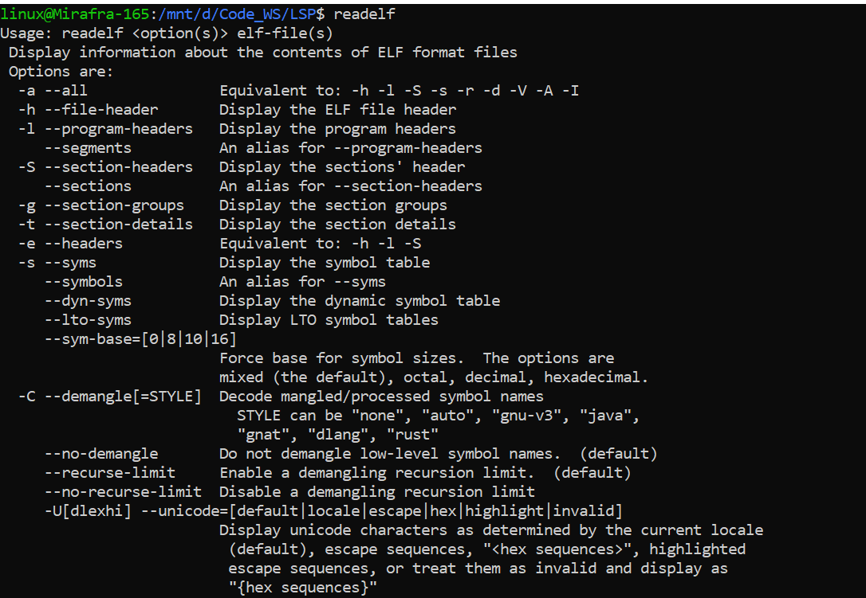
Working with readelf command and ELF files
readelf
When we compile source code, an object file is generated of the program and with the help of linker, this object files gets converted to a binary file which only the machine can understand.
This kind of file follows some structures one of which is ELF(Executable and Linkable Format).
And to get the information of these ELF files readelf command is used
To display help of readelf command

Slide 5
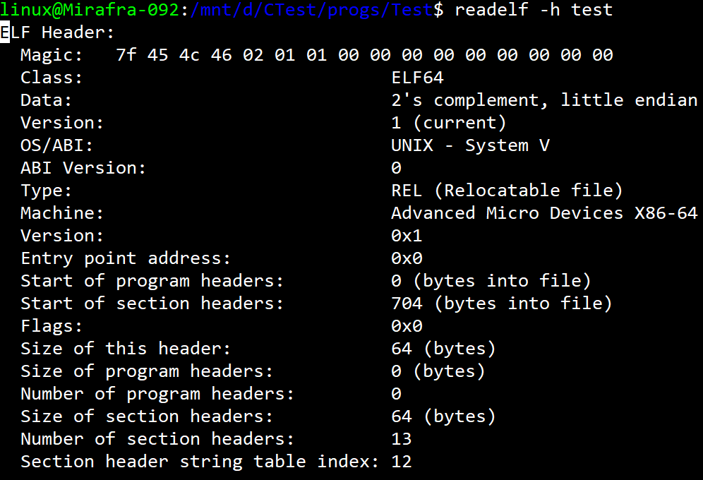
2. To check whether a file is ELF file.
3. To generate a elf file using gcc compiler.
4. To display file headers of a elf file.

Slide 6
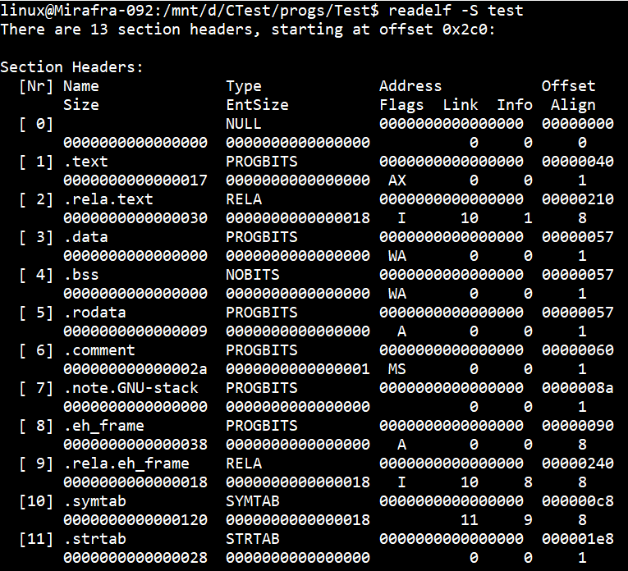
5. To display information about the different sections of the process’ address space.

Slide 7
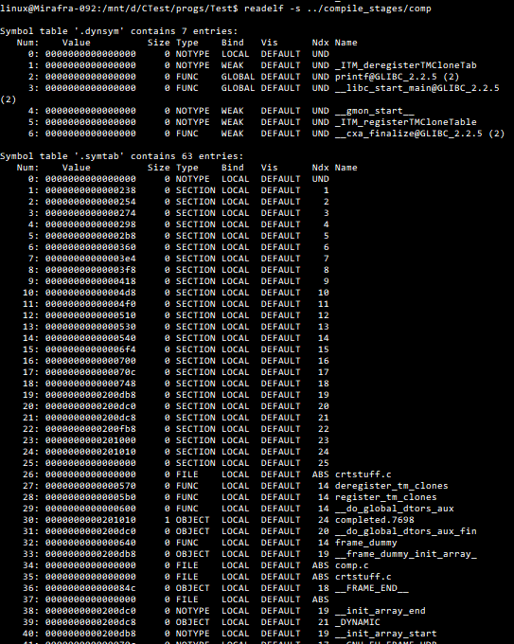
6. To display symbols table

Slide 8
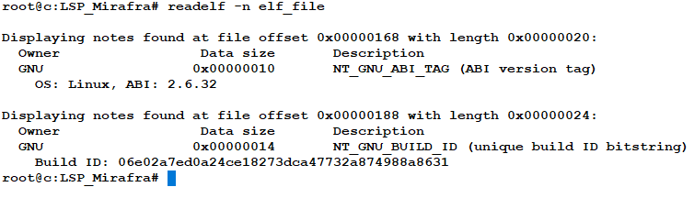
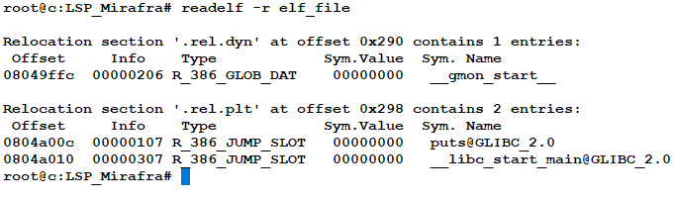
7. To display core notes.
8. To display relocation section

Slide 9
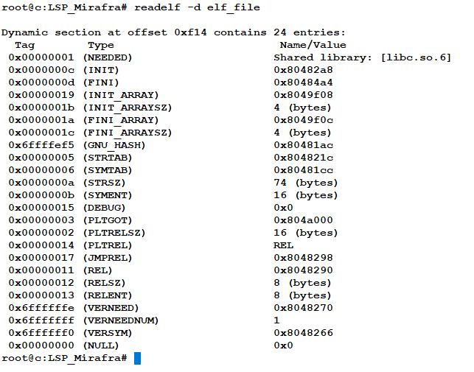
9. To display the dynamic section.

Slide 10
Objdump
When we have an object file and we don’t have the source code with us and we have to find out the maximum information from the file.
To do so objdump plays a very vital role.
The main purpose of the objdump command is to help in debugging the object file.
It is used for the following listed purposes:
To retrieve archive header
To get the offset of the file
To get the bfdname
To get the demangle
To debug the file
To disassemble the file
To retrieve the file headers

Slide 11
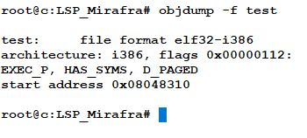
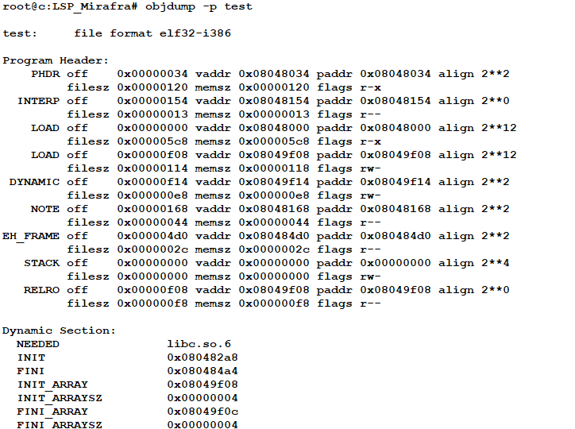
1. To get the file headers of an Object File.
This command will print all the file headers related information of the file.
2. To print the object-specific file header content.
This command will print the object-specific file header content of the file

Slide 12
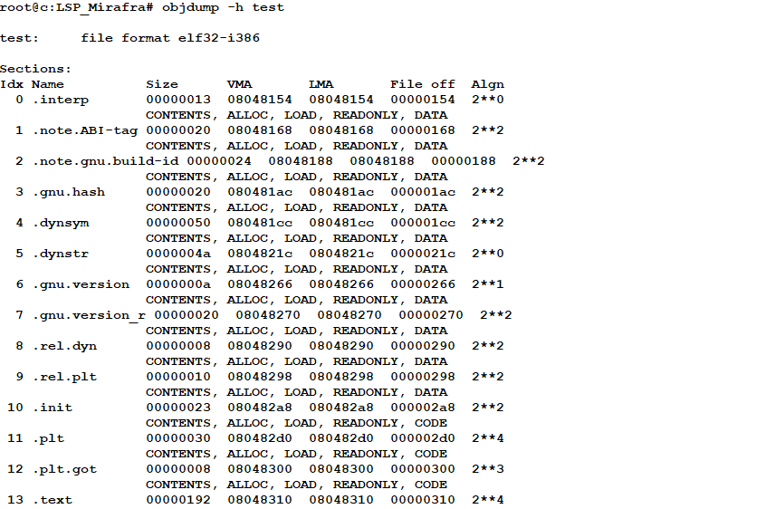
3. To print the section header content of the file.
This command will print all the section header related information of the file

Slide 13
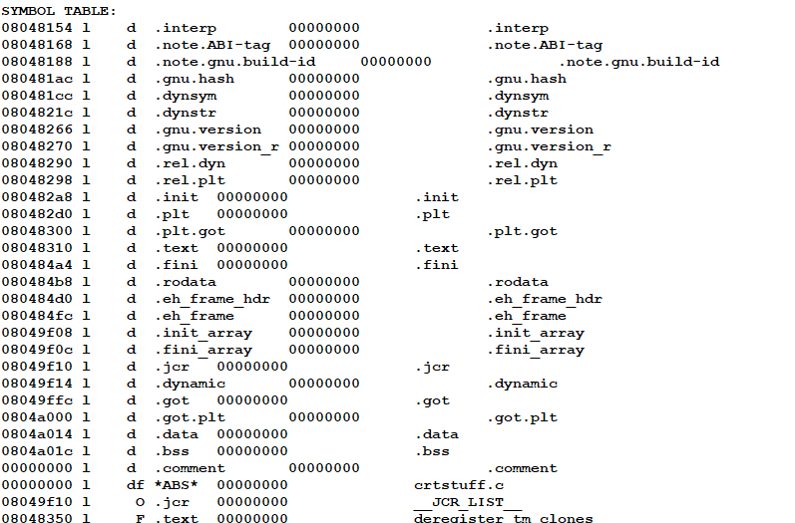
4. To print the all header content of the file.
This command will print all the content header related information of the file.

Slide 14
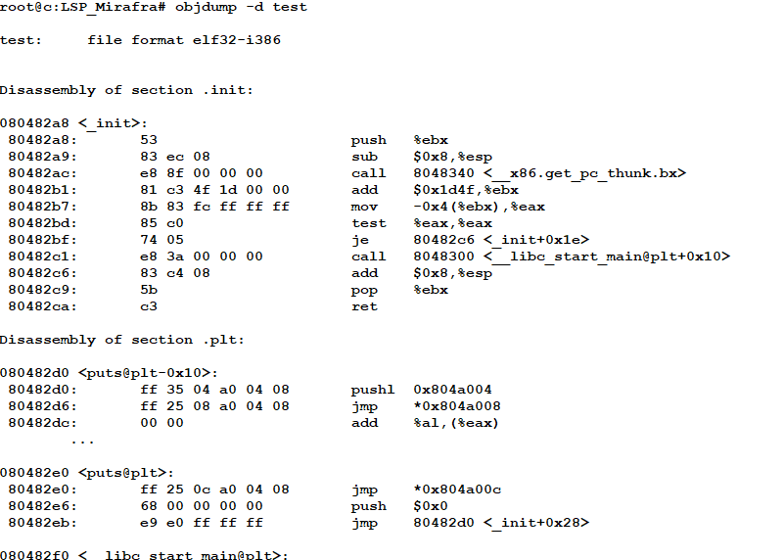
5. To print the assembler content of the sections capable of execution.
This command will print the content of the assembler of sections that are executable.

Slide 15
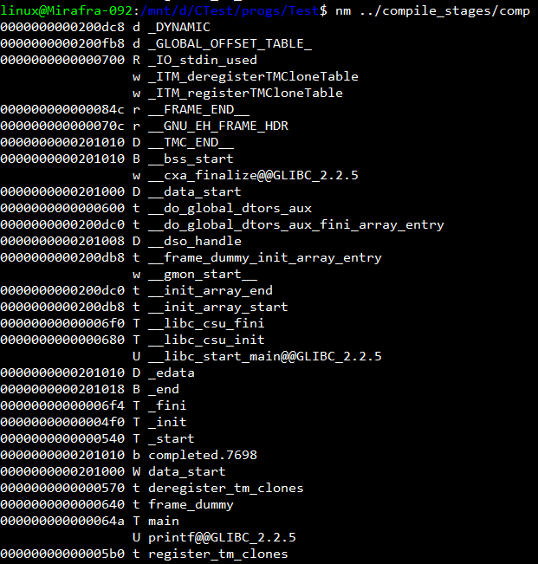
nm tool

Slide 16
Thank you!!!

